Slide 1
ENEMIES AI
Fernando Freixinet

Slide 2
COMBAT ARCHETYPES

Slide 3
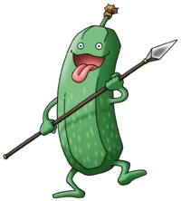
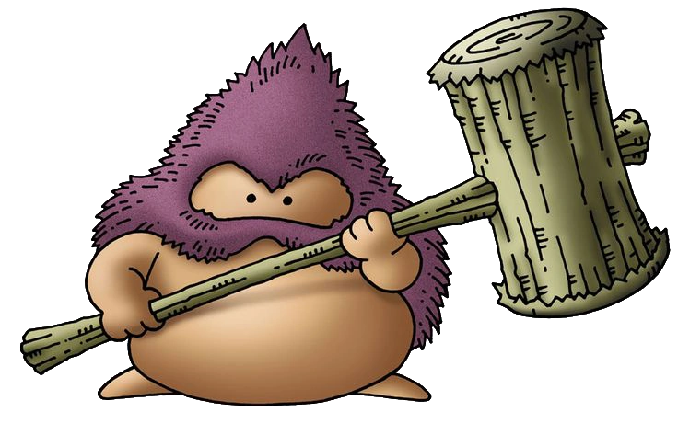

AGGRESSIVE
Low life pool and damage
This type of enemy will just attack the player
No priority (Random Target)

Slide 4
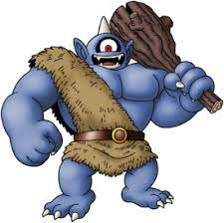
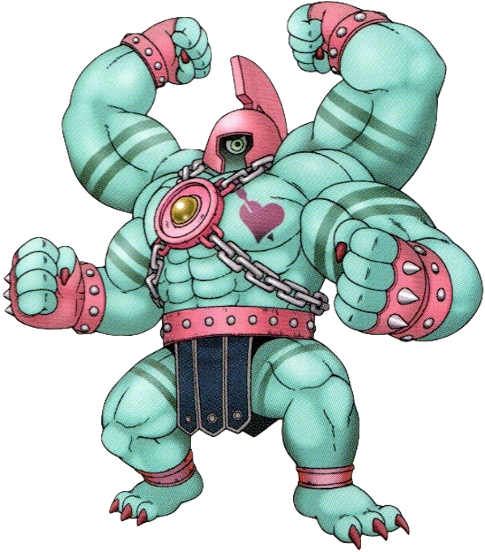
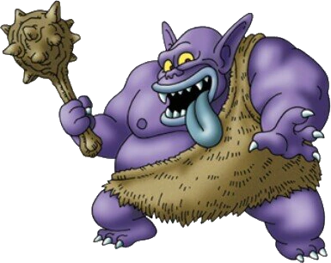
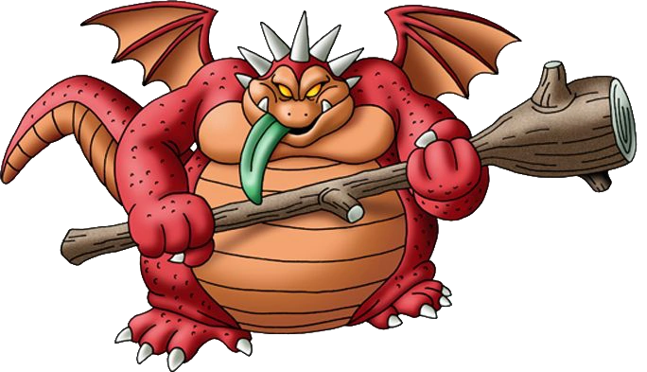
ANTI-TANK
High life pool and strong attacks
Usually targets characters with more hp/defense (but not always)
Usually are weak against some type of altered state

Slide 5
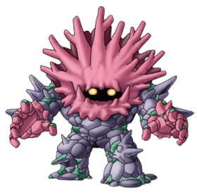
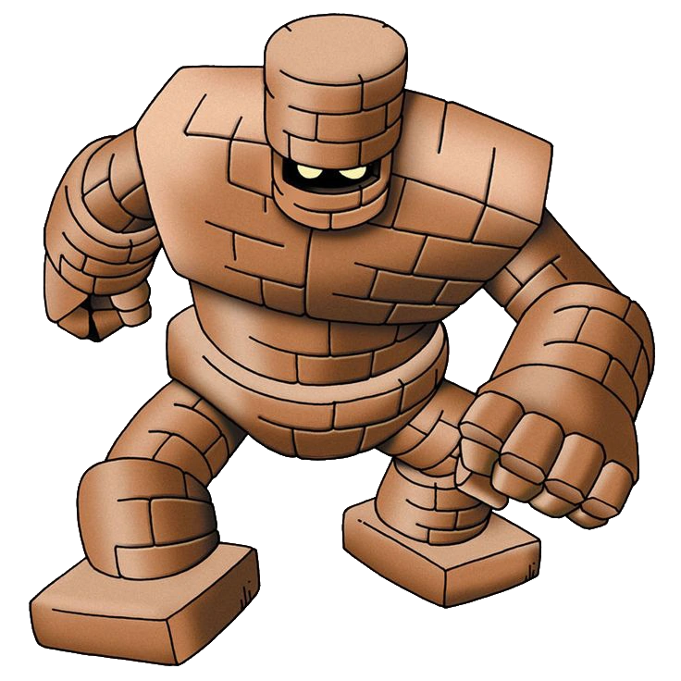
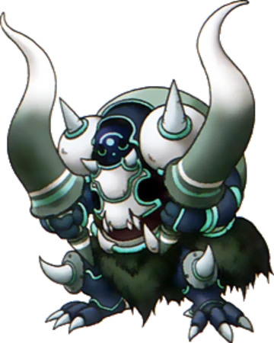
TANK
High life pool/defensive skills
Some might have skills that focus attacks on them

Slide 6
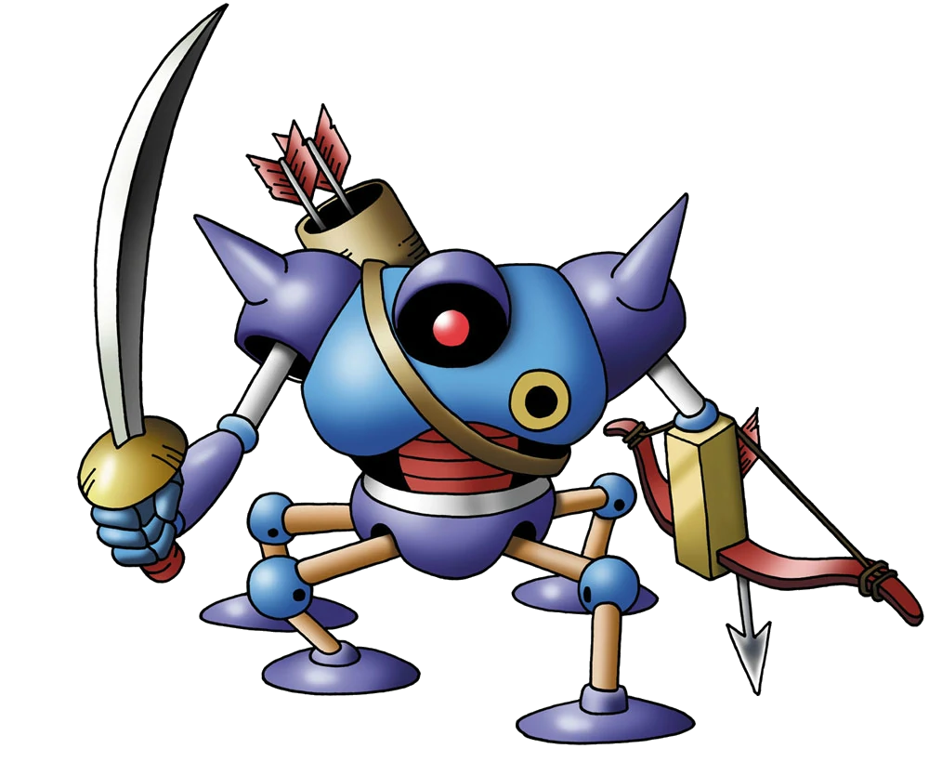
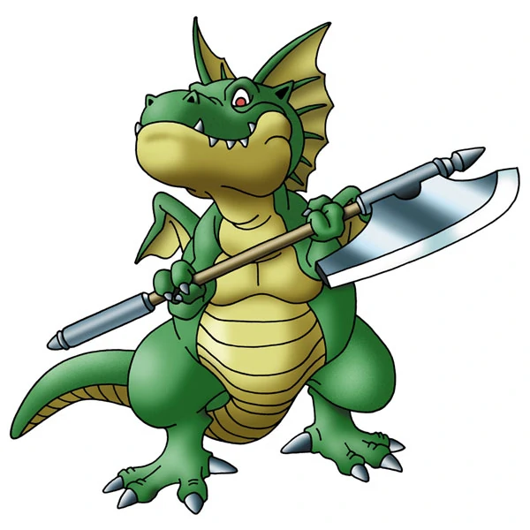
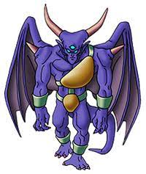
ASSASSIN
High damage
They usually use single-target attacks
They usually focus low hp/defense characters

Slide 7

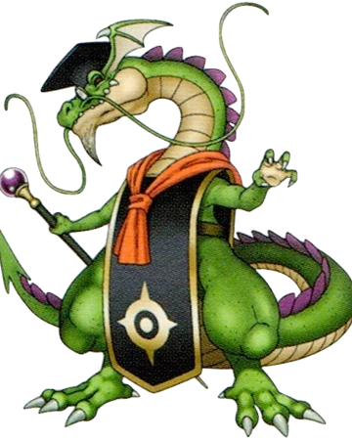
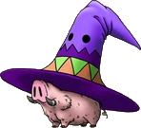
CASTER
High damage and low life pool
They usually use multi-target skills

Slide 8

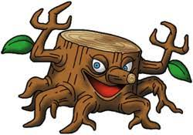
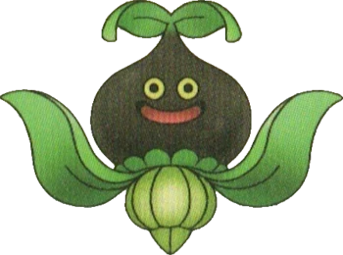
SUPPORT
Low life pool
They heal and buff other enemies
They almost never attack

Slide 9
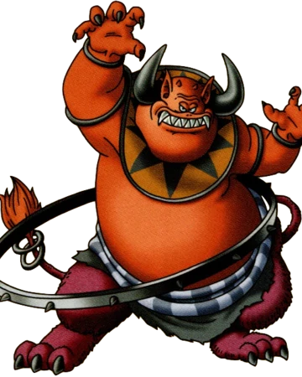
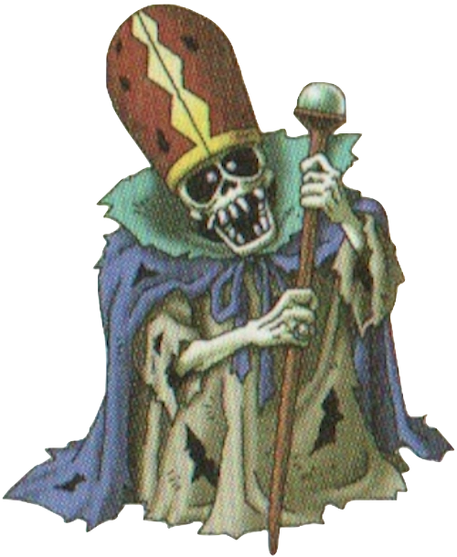
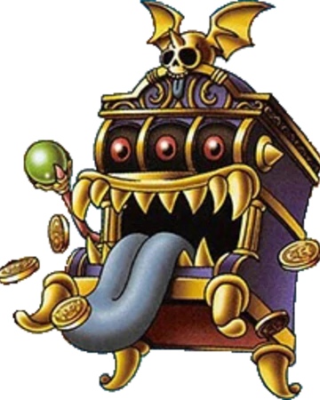
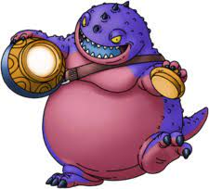
SPAWNER
Low life pool
They call more monsters into battle
They don’t usually attack unless the battle is full

Slide 10

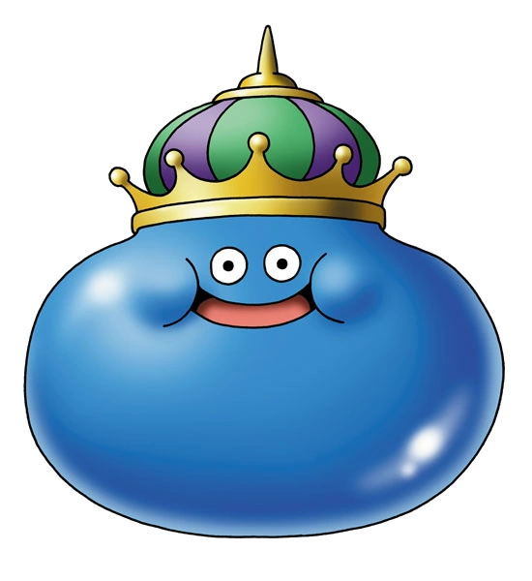

MERGER
Low life pool and damage
They will attack or call more monster of the same type at a similar rate
If the number of monsters reaches certain point, they can merge into a more powerful enemy
3x
8x

Slide 11
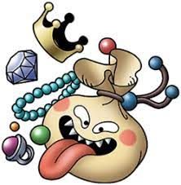


REWARD
These enemies have increased health/defense and probability to flee
When slain, they will give a valuable reward
Gold
XP
Item

Slide 12
OTHER USES OF AI

Slide 13

AGGRO
When the player is in the world scene, if they pass near a enemy it will start chasing the player
If the party is underleveled, enemies will aggro with more range and chase with more speed

Slide 14

FLEE
If the party is overleveled for the current zone, enemies will flee on seeing them
This happens in the world and combat scenes

Slide 15
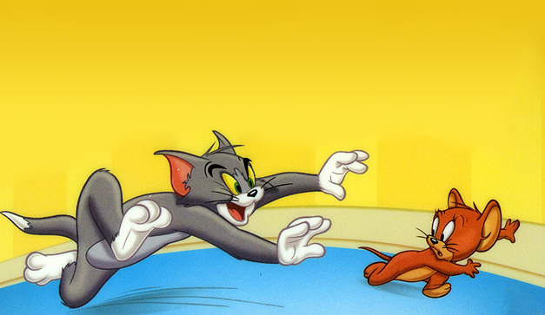
BLOCK ESCAPE
If the party tries to flee and fails, the enemies will use this opportunity to attack

Slide 16
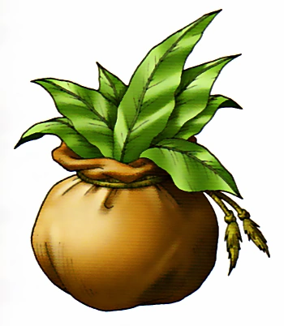
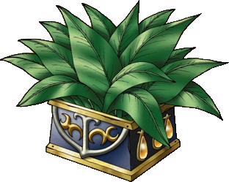
ITEM USAGE
If the enemy is able to drop a specific item and certain conditions are met during battle, the enemy will use the item

Slide 17
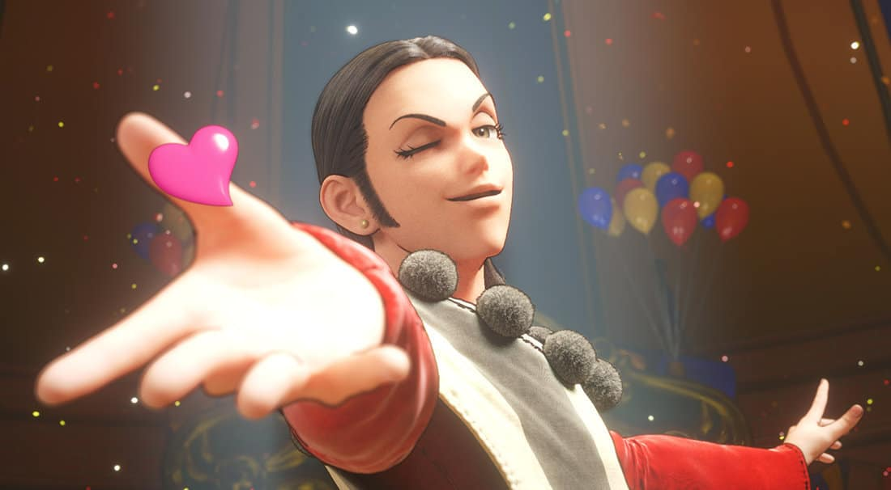
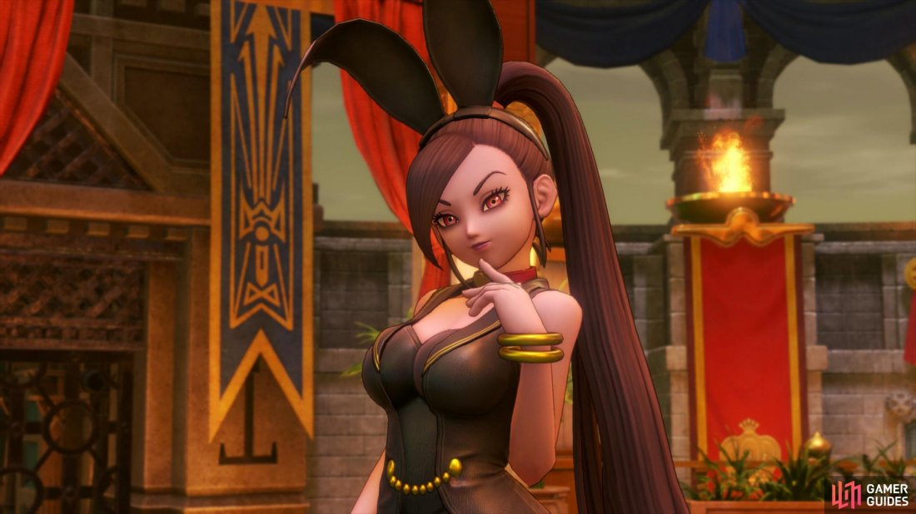
ENEMY TAMING / CHARMING
If an enemy is charmed (altered state) it will fight with your party for a number of turns, but you can’t control it
If you use certain abilities and/or items onto an enemy it may want to join your party when slain. This only applies to some games of the saga but these enemies act like complete characters so you can equip and control them.

Slide 18
EXAMPLE BOSSES

Slide 19
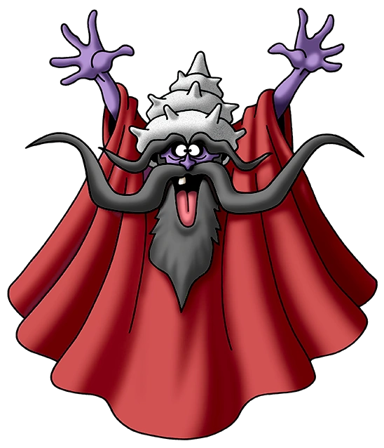
MALICIOUS GREY GORDON
This boss is a spawner and a support
The spawned monsters are casters and supports
Its attacks and those of their allies are almost-all altered states

Slide 20
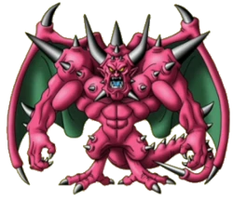
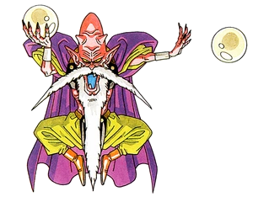
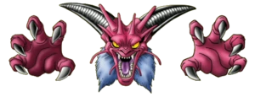
MORTAMOR
1. Caster
2. Anti-Tank
3. Caster + 2x Supports

Slide 21
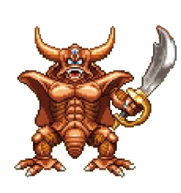
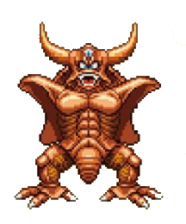
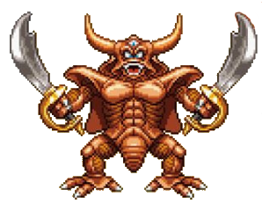
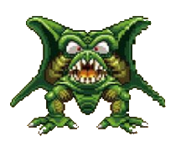
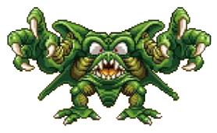
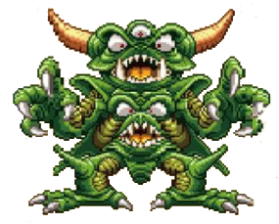
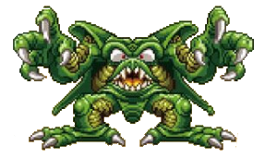
PSARO
As it loses his arms, he will switch from physical attacks to magic
When it gains his body parts again, it will use physical attacks again
When it turns to green, it unlocks the most dangerous magic

Slide 22
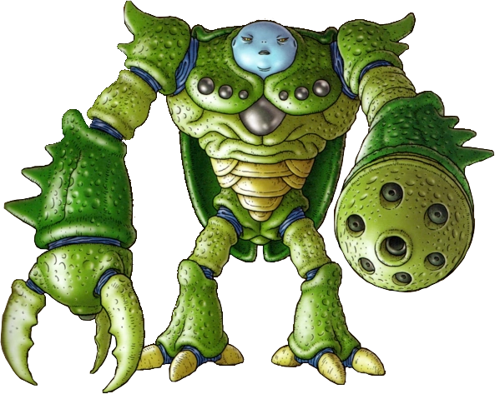
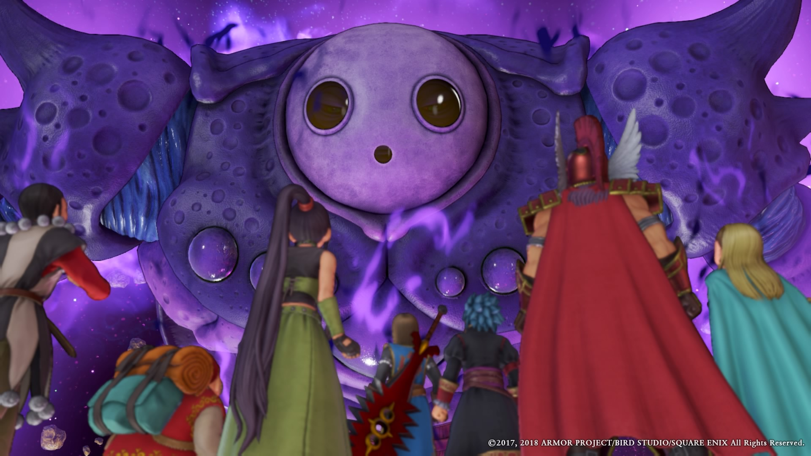
CALASMOS
If the player uses a specific item during the fight, Calasmos will lose defenses and the capacity of doing certain skills
This is only transmitted to the player through the storyline, no tips during the encounter

Slide 23
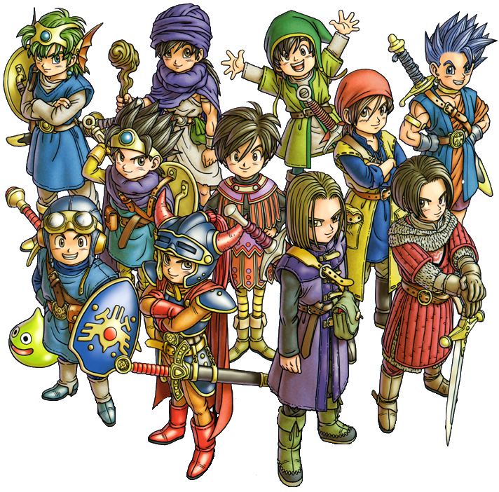
THANKS FOR YOUR ATTENTION

